Slide 1
Weather report prediction by using machine learning python

Slide 2
Hello! Presented by NAME: JSK Hema Shri

Slide 3
Agenda :
Introduction
Tool specification
Data collection
Auto regressive model
Prediction
Result & conclusion

Slide 4
Introduction
Weather is a important aspect of a person life as it can help us to know when it will rain and when it will be sunny. Weather forecasting is the attempt to predict the weather condition at some future time and the weather conditions that may be expected. The climatic conditions parameters are based on the temperature, pressure, humidity, dewpoint, rainfall, precipitation, wind speed and size of data set. The parameters temperature, pressure, humidity, dew point, precipitation, rainfall is only considered for experimental analysis.

Slide 5
Tool specifications
Import Pandas as pd
Import Numpy as np
Import Matplotlib.pyplot as plt
Import datetime
From sklearn import (pipeline , preprocessing , metrics , model_selection , ensemble)
From sklearn_pandas import DataframeMapper.

Slide 6
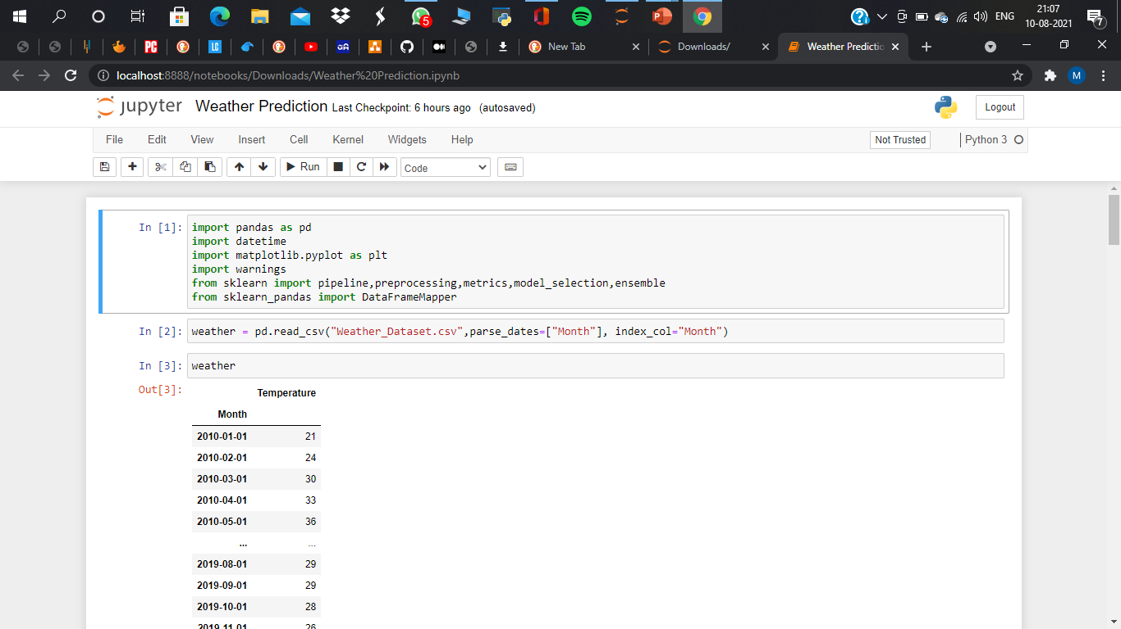
Data collection
# 1 Raw data
We have to download the historical raw data of weather report from google for weather report prediction
# 2 import libraries
Import pandas as pd , and import numpy as np , import matplotlib.pyplot as plt , from sklearn pipeline , preprocessing , metrics , model_selection , ensemble , from sklearn_pandas import DataFrameMapper .

Slide 7
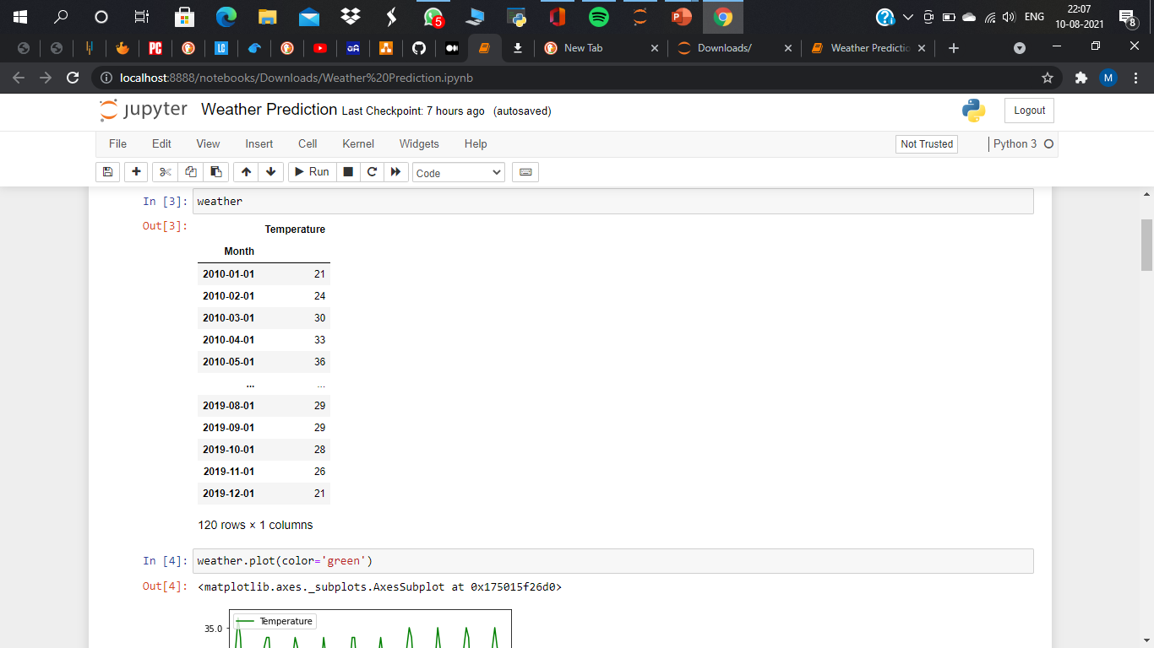

Slide 8
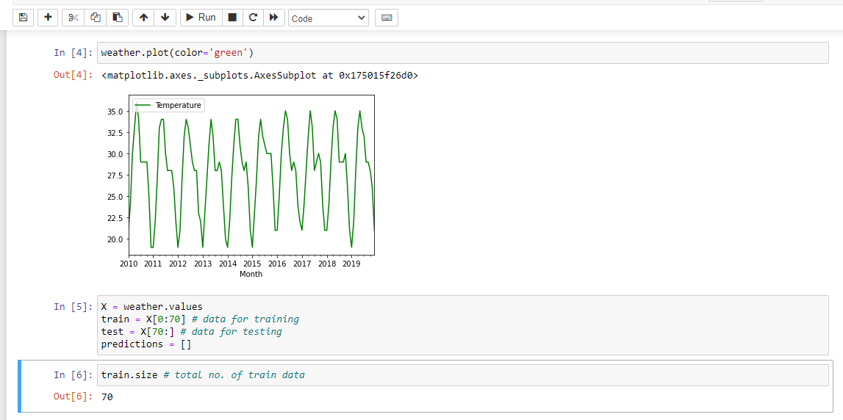
Month & Year \ temperature prediction

Slide 9
The project simply uses temperature for training the data. Here these data are then trained using Auto-Regressive model for the prediction.
There are many research papers that have been published related to predicting the weather. A paper was published. That paper proposes a modern method to develop a service oriented architecture for the weather information systems which forecast weather using these data mining techniques. This can be carried out by using artificial neural network and decision tree algorithm data collected in specific time. Algorithm has presented the best results to generate classification rules for the mean weather variables. The results showed that these data mining techniques can be enough for weather forecasting . Another paper was published on ‘Analysis on The Weather Forecasting and Techniques’ where they decided that artificial neural network and concept of fuzzy logic provides a best solution and prediction comparatively . They decided to take temperature, humidity, pressure, wind and various other attributes into consideration.

Slide 10
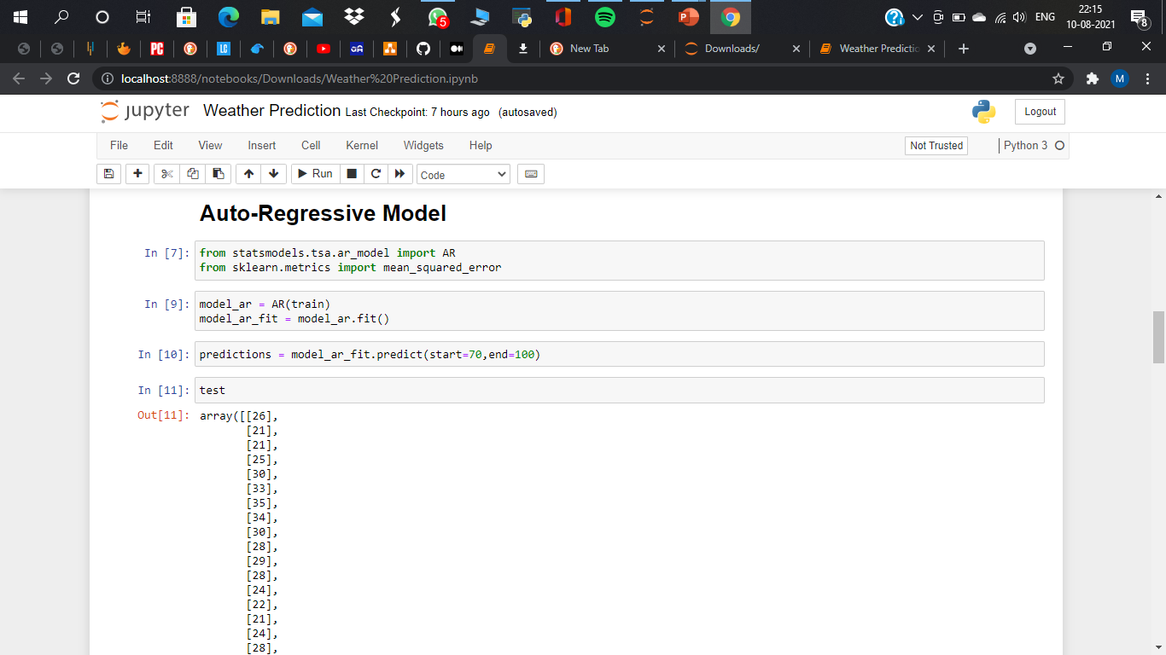
Auto – Regressive model
The project simply uses temperature for training the data. Here these data are then trained using Auto-Regressive model for the prediction.

Slide 11
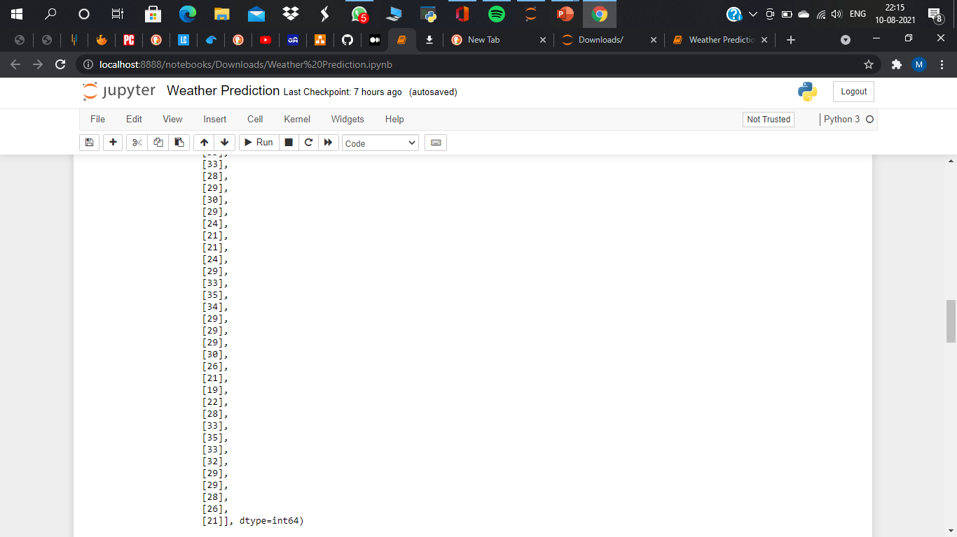

Slide 12
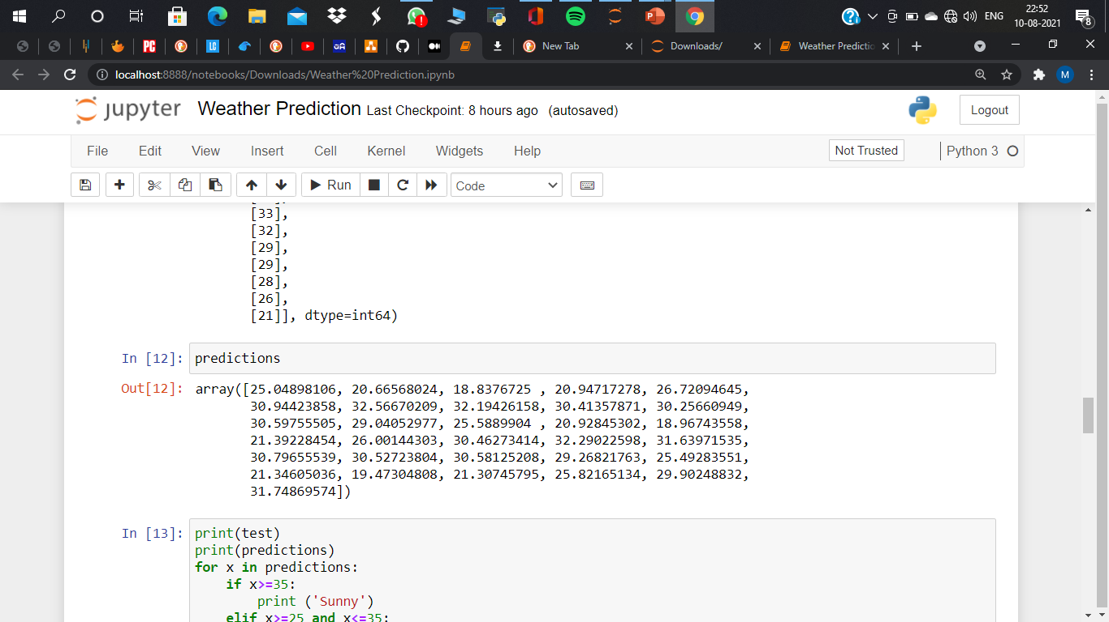
Predictions

Slide 13
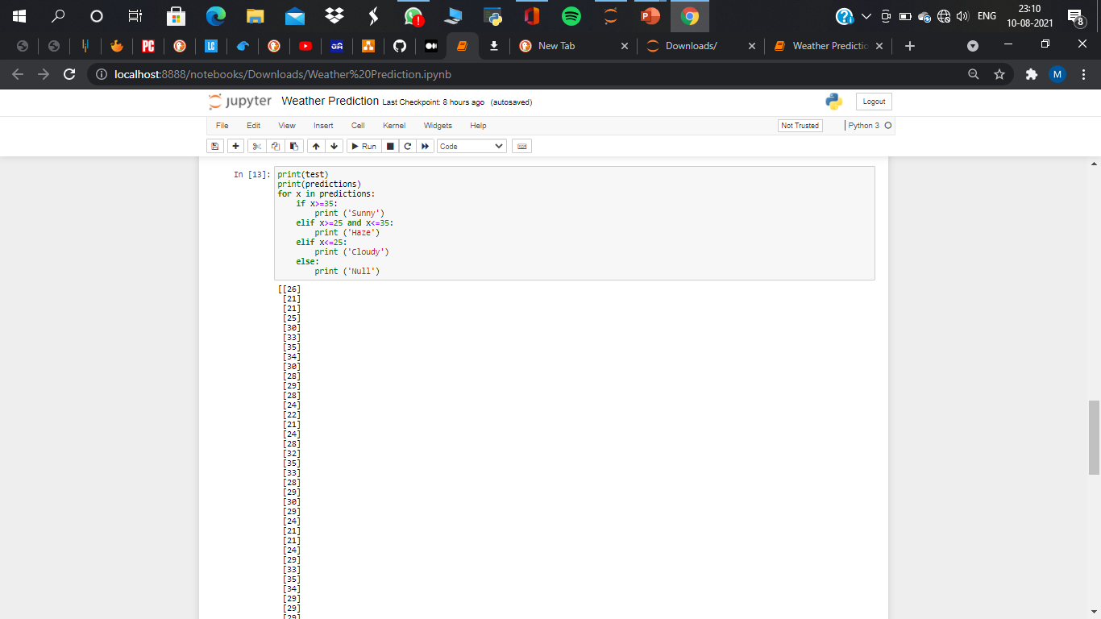
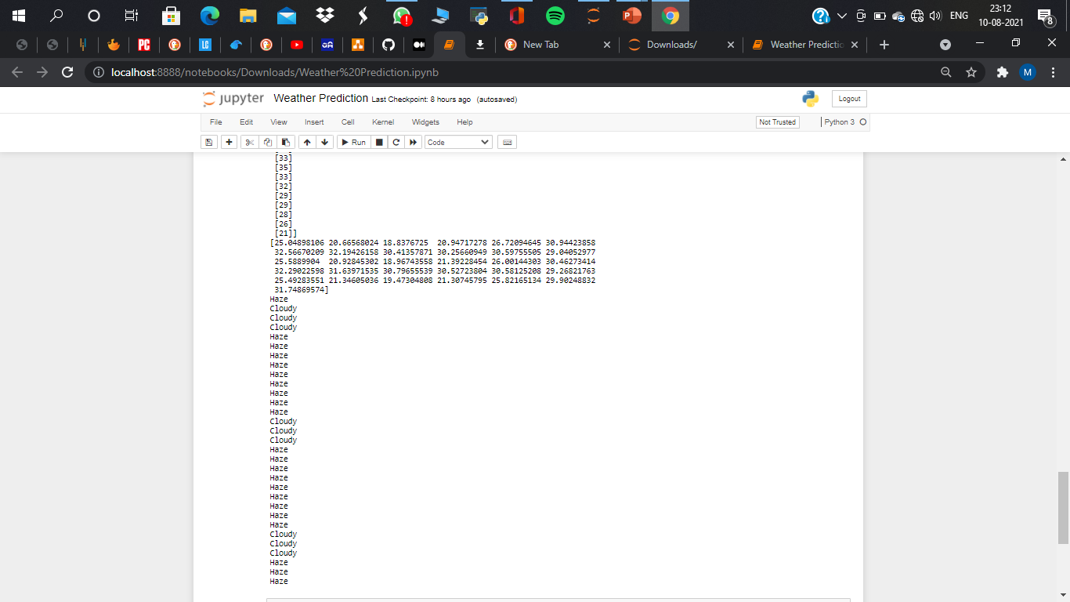

Slide 14
Result :
The prediction system works properly. The values of all the attributes were properly pre-processed. After all the pre-processing was completed, model was implemented and it was trained using train data. Our accuracy was found to be around .
Conclusion :
The weather prediction done using auto-regressive model and are very essential for improving the future performance for the people. For predicting the weather, the auto-regressive model was applied to the datasets of the weather. We made a model to predict the weather using some selected input variables collected from Kaggle. The problem with current weather scenario is that we are not able to prepare our self and not able to do some important works. So, for knowing the weather scenario at high accuracy considering every factor that affects in the weather scenario, this model is created.

Slide 15
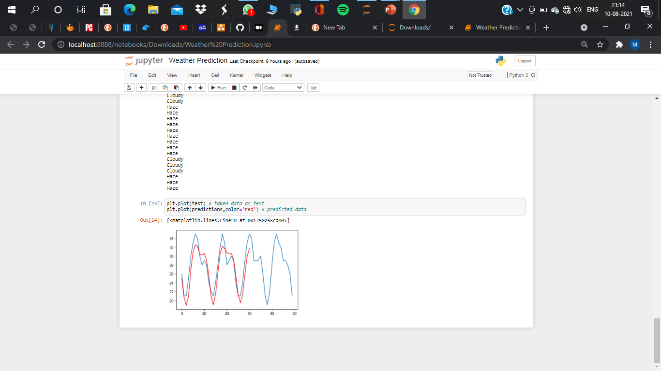
RESULT AND CONCLUSION

Slide 16
THANK YOU

